Slide 1


Medical Inventory Optimization Dataset
NAME: LATIKAA TEJUS.J
COLLEGE: K.L.N.COLLEGE OF ENGINEERING
CITY/STATE: MADURAI(625016)/TAMIL NADU
EMAIL: tejus252002@gmail.com
PHONE NUMBER: 9790362543

Slide 2
Contents
Business Objective
Business Constraints
Project Architecture
Data Collection
Exploratory Data Analysis
Data Visualization
Notes:
Change

Slide 3
Business Problem
Business Problem:
Bounce rate is increasing significantly, leading to patient dissatisfaction.
Business Objective:
To Minimize bounce rate
Business Constraint:
TO Minimize inventory cost
Success Criteria:
Business Success Criteria: Reduce bounce rate by at least by 30%
Economic Success Criteria: Increase revenue by least 20 lakhs INR by reducing the bounce rate

Slide 4
Project Overview and Scope
Data Analysis and Identification of Bounce Rate Factors:
Gather and analyze historical data to identify patterns and factors contributing to high bounce rates.
Conduct surveys or interviews with patients and staff to gain qualitative insights.
2. Strategy Development:
Implement measures to enhance the patient experience and reduce bounce rates.
Prioritize strategies based on their potential impact on reducing bounce rates while considering inventory costs.
3. Implementation and Testing:
Implement selected strategies on a trial basis in specific areas or departments.
Continuously monitor and measure the impact of implemented changes.

Slide 5
Project Overview and Scope
4. Optimization and Scalability:
Fine-tune successful strategies based on real-time feedback and data analysis.
Create a framework for continuous improvement and adaptation to evolving patient needs.
5. Cost-Effectiveness and Revenue Enhancement:
Ensure that proposed solutions are financially feasible and align with the constraint of minimizing inventory costs.
Measure the economic impact of bounce rate reduction on revenue generation.
6. Reporting and Evaluation:
Generate regular reports detailing progress, successes, and challenges faced during the project.
Evaluate against set success criteria and make recommendations for further improvements if needed.

Slide 6
Data Dictionary
Patient Information:
Variables: Name, age, gender, contact details, medical history, previous interactions with the healthcare system.
Bounce Rate Metrics:
Variables: Entry point, exit point, time spent, pages visited, reason for exit, frequency of bounces.
.
Inventory Data:
Variables: Type of inventory, quantity, usage frequency, replenishment cycle, cost per unit.
Patient Feedback and Surveys:
Variables: Rating, comments, suggestions, satisfaction scores.
.
Analytics and Modeling Parameters:
Variables: Predictive models, algorithms used, key performance indicators (KPIs).

Slide 7
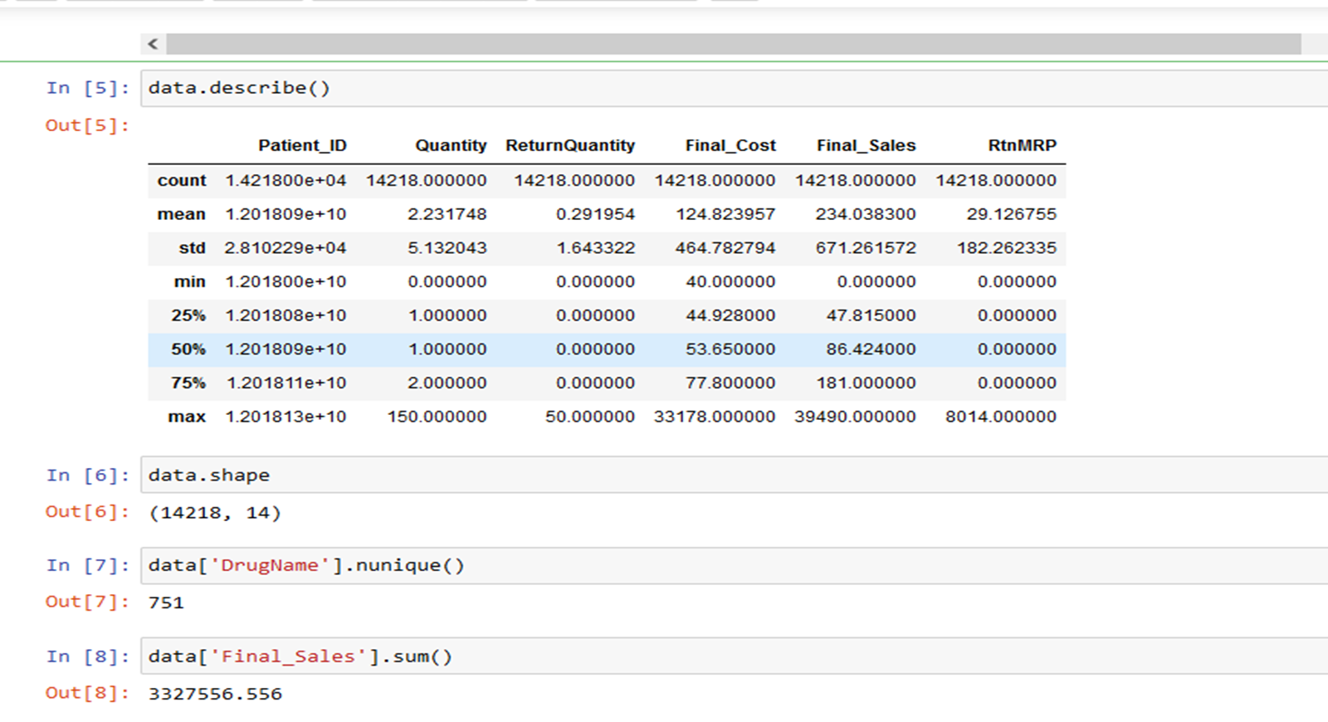
Exploratory Data Analysis [EDA]
Statistical Insights
Business Insights
Total Unique drugs : 751
2.Total revenue generated on 2022 is 33,27,556 excluding all the money from returns.
3. The highest revenue generated month is December .
4.The month with most returns is August.
5.1681 is the total counts of returns in the year 2022.
Notes:
EDA is used for seeing what the data can tell us before the modeling task.
Change

Slide 8
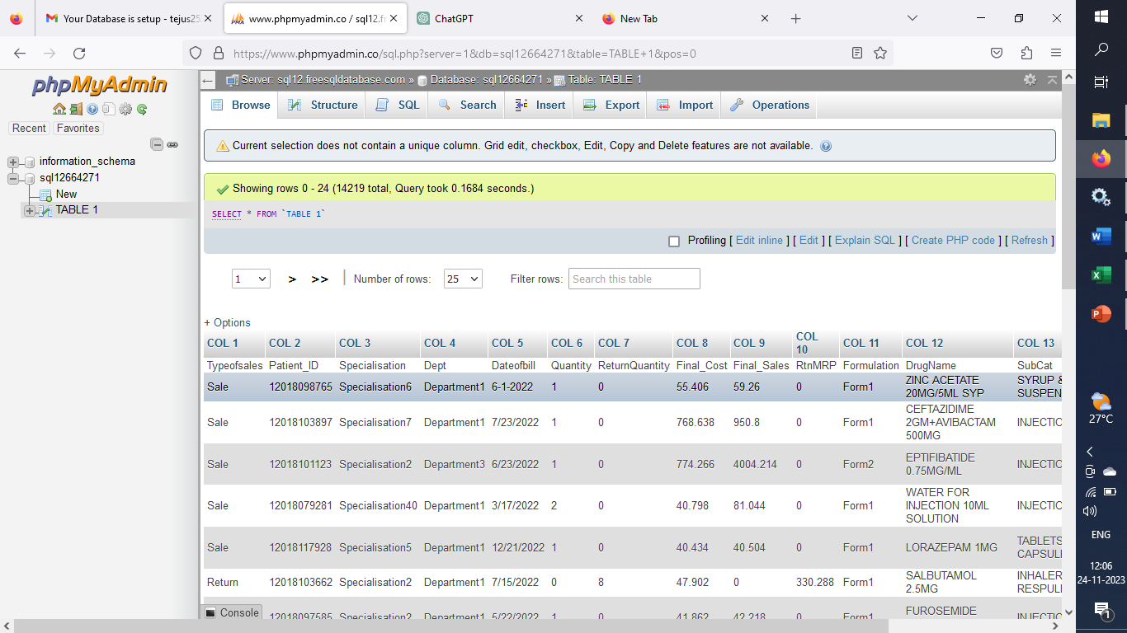
Data Preprocessing
Notes:
Keep observations

Slide 9
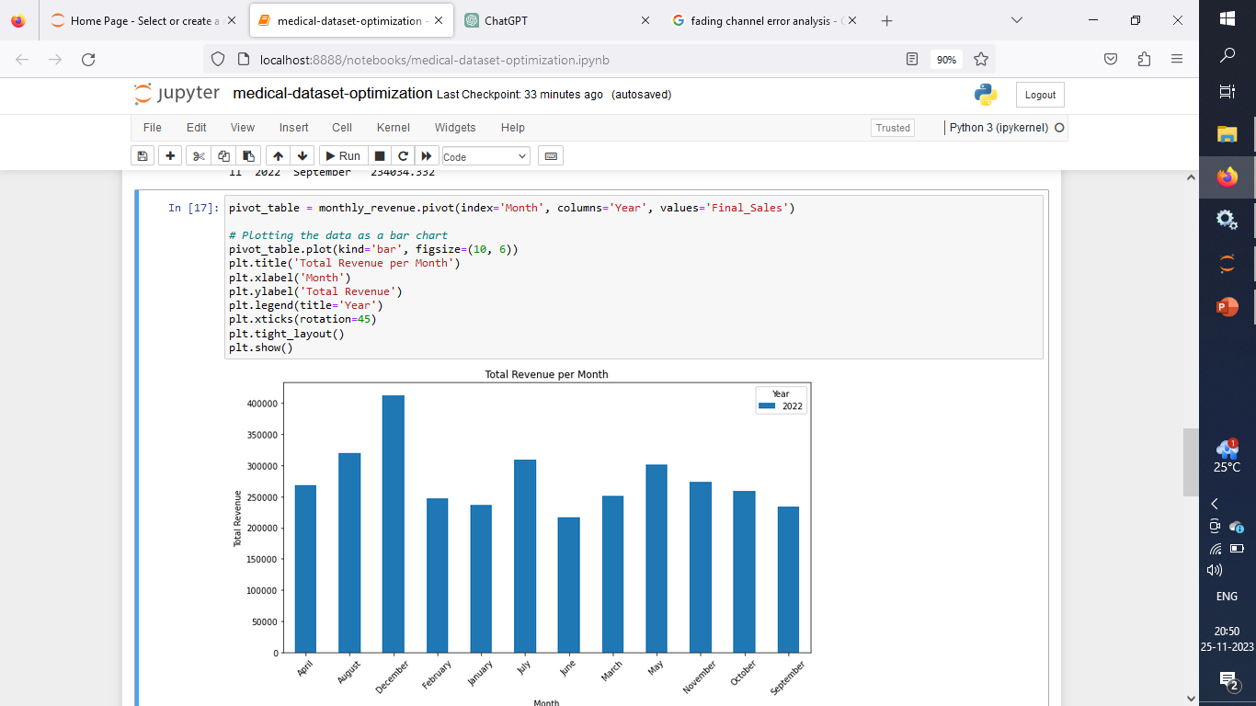
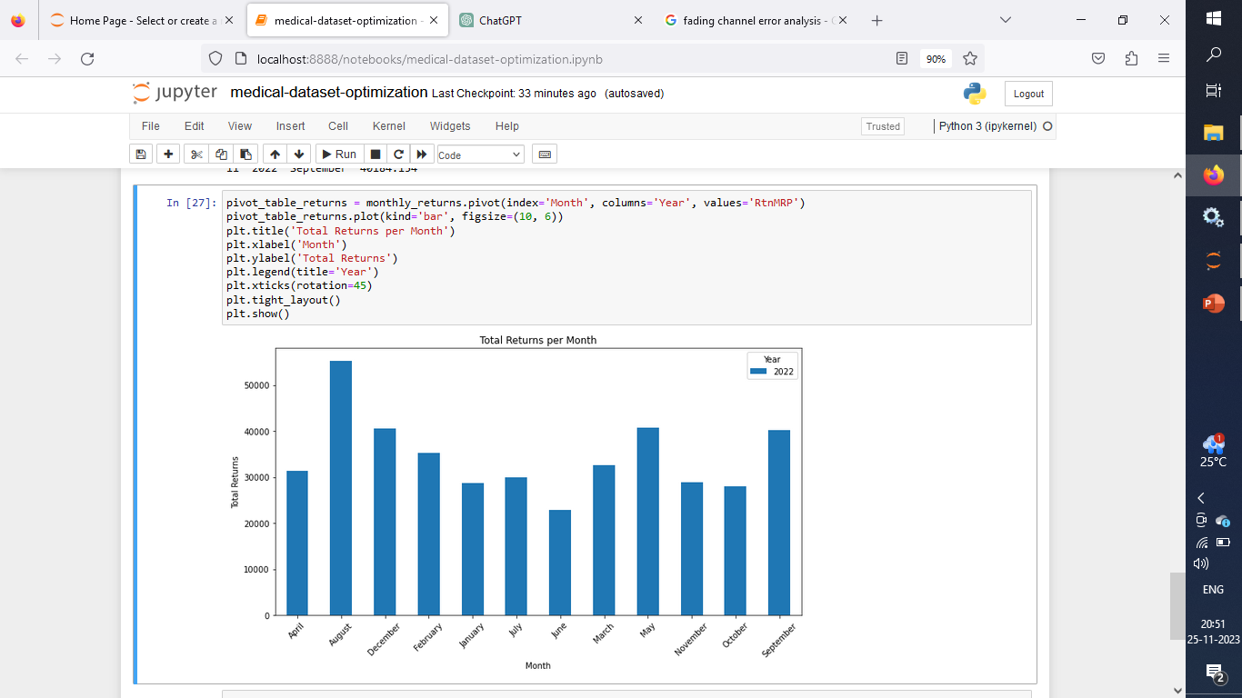
Data Visualization
Month wise revenue generated on 2022
Month wise return-drug money
Notes:
Add graphical

Slide 10


